Slide 1
Hospital Management/Appointment Application System.
Vasu Rastogi (20bcs5135)
Hemang Patel (20bcs5184)
Inderjeet Singh(20bcs5138)
Madhav Upadhaya(20bcs5121)
(Chandigarh University, Computer Scinece and Engineering)
Er. Reema Goyal
Er. Deepika

Slide 2
Introduction..
The main purpose of “ Appointment Application form ” is to provide a convenient way for a Admin to know about patients. The objective of this project is to develop a system that automates the processes taking the valuable data from the user and give them the appointment. We have designed this page such as to retend the user by showing him authentic ui. This project is developed to replace the currently existing system, which helps in keeping records of the patient details.

Slide 3

Objectives..
This application is develop to provide the appointment to the patients at their home instead of calling. We provide the form to the patients which is to be filled for the appointment . Emergency care 24x7 , Support groups and Support and help through calls is provided. This application tends to provide the simplest steps to book the appointment for the patients.

Slide 4

Methodology..
We have used modern web languages to design this interactive UI for the users of Hospital Management/Appointment Application System to enter their data into the form and get their appointment booked.
HTML
CSS
Javascript
Php
Coding platform.
VS-Code

Slide 5
Implementation…
Run Xammp
Start Mysql and Apache
Go to:- C/xammp/htdocs
Open browser and type localhost/geeko

Slide 6
How we have created this ?
UI design
Database creation
Database connection using php
Responsive design for users

Slide 7
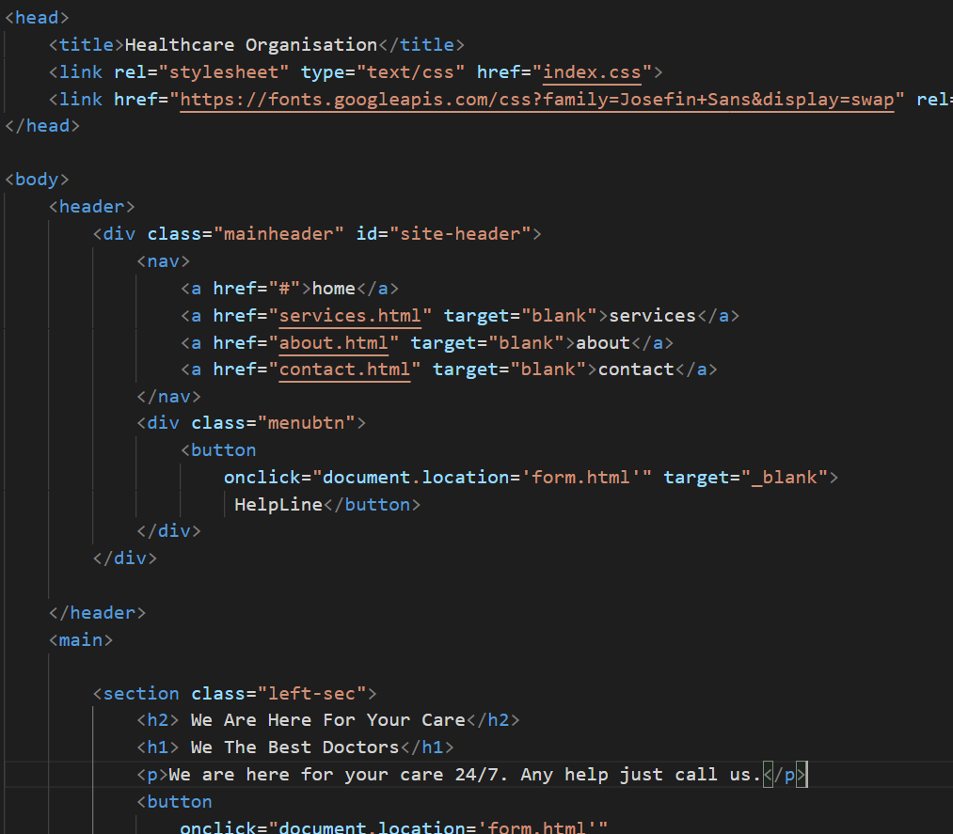
Code(HTML)..

Slide 8
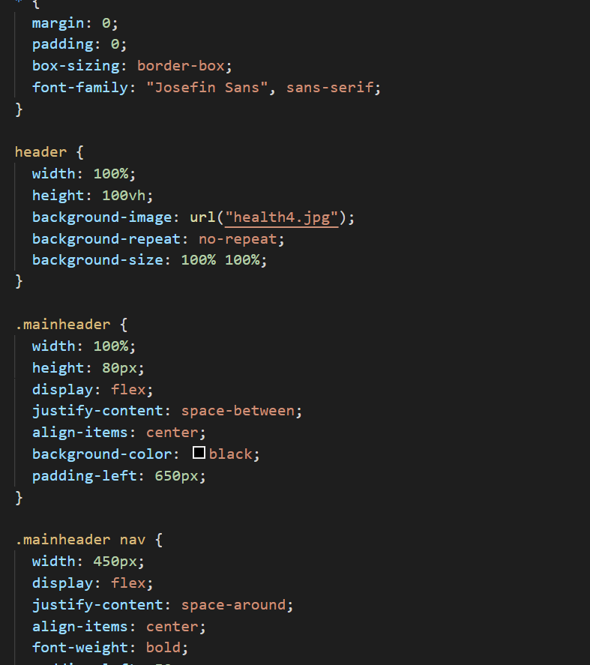
CODE(CSS)..

Slide 9
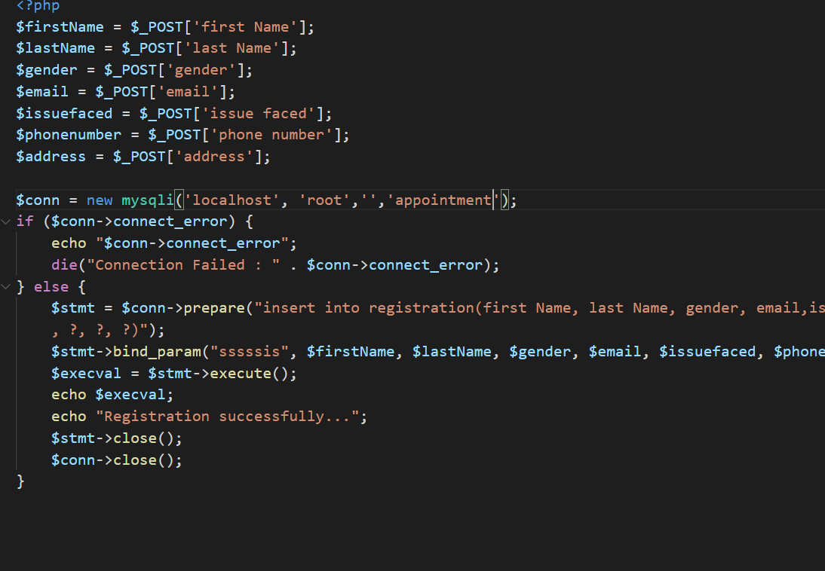
Code(php)..

Slide 10
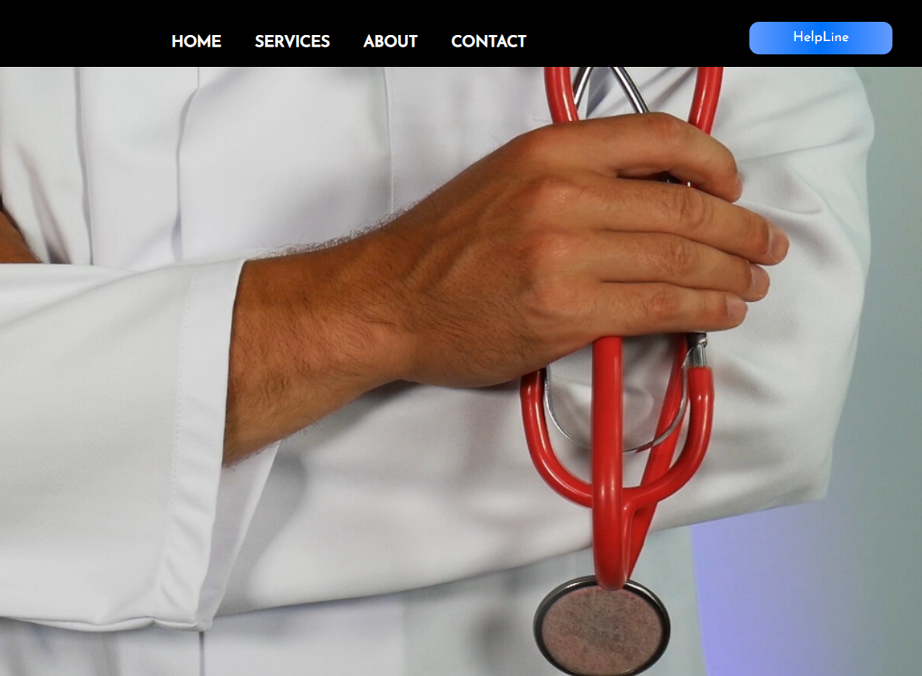
Result..

Slide 11
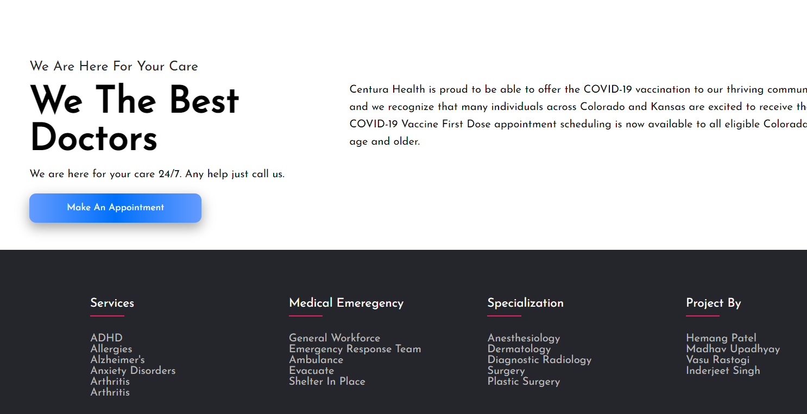
Result..

Slide 12
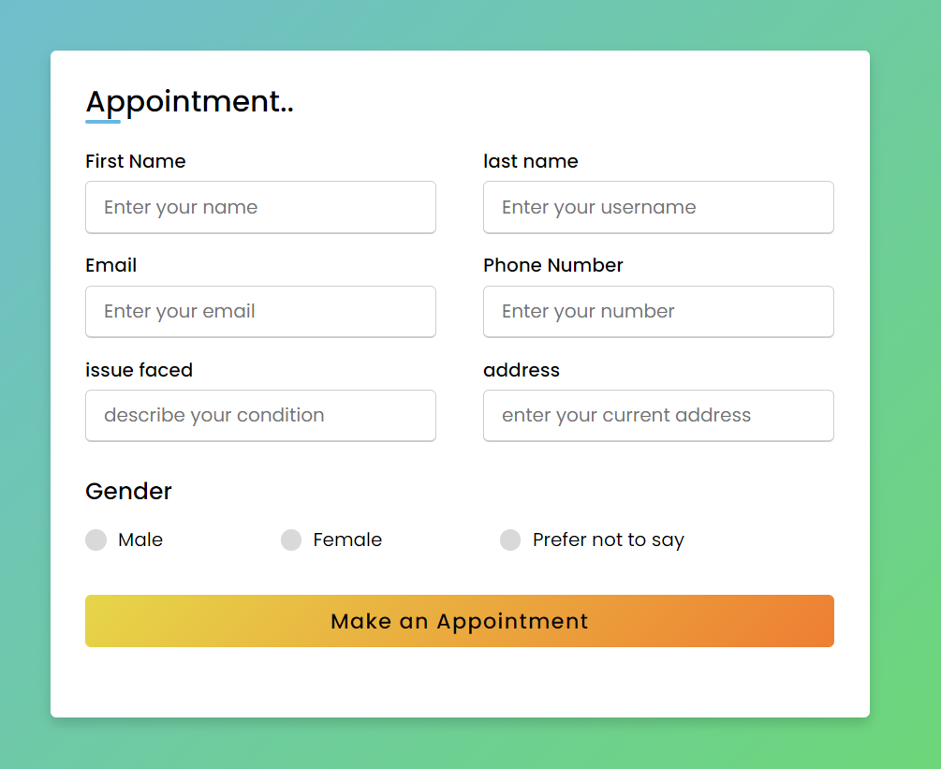
Result..

Slide 13
Conclusion..
In this Project, we made a website and also sought evidence from the literature to discuss the benefits and challenges of implementing Web-based medical appointment systems. Compared with traditional appointment methods, Web-based appointment scheduling is more patient-centered and has many advantages due to improved access. After implementing Web-based appointment systems, many practices have shown positive changes such as reduced no-show rate, decreased staff labor, decreased waiting time, and improved patient satisfaction.

Slide 14

Future Scope..
As the main objective of this project is to create a survey for the user so in near coming future we will be working on to add many more functionalities
We will be creating a backend team for on call support
We will add Admin section also, where admin have the options to manage and add different new schemes and plans
We will adding online video call support with doctor for better understanding.

Slide 15
References…
W3schools
Traversy Media
Thapa Technical
Wikipedia
Php.net
Csstricks.com
Freecodecamp.com
IEEE/Harvard

